Slide 1
A Presentation on IMAP
Presented by:
Sandesh Lawaju(730335)

Slide 2
About IMAP
Internet message access protocol
1986, Stanford University
Stands for accessing electronic mail that are kept on a server
Access messages from more than one computer
More than one user
IMAP protocol based on a TCP connection (port 143)

Slide 3
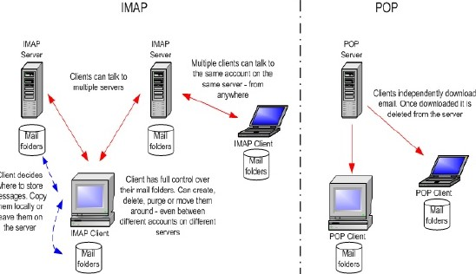
IMAP v/s POP

Slide 4
Procedure of the IMAP protocol
All emails are kept on a mail server
Functionality :
Treat ad local directory
Work directly on server
Copy
Delete
Different folders
Download message headers and later on the full messages

Slide 5
Procedure of the IMAP protocol(contd..)
Communication procedure
Connection initialization
Welcome of the server
Interaction between client and server
Connection closed

Slide 6
Interaction between client and server
Client sends data – server receives :
Client-command begins with alphanumeric string (‘tag’) e.g. App1 which is created for every new command
Then the command with corresponding arguments follows
Server sends data – client receives
Server receives and works with the command
Returns the same tag with a state(OK/NO/BAD)
Additional information begin with ‘*’ (untagged)
Untagged information can be sent at every time

Slide 7
Different states of an IMAP session
Most commands are only valid in special states (otherwise: protocol error)
4 states (initialization is not an own state)
Non-Authenticated
Authenticated
Selected
Logout, Closed

Slide 8
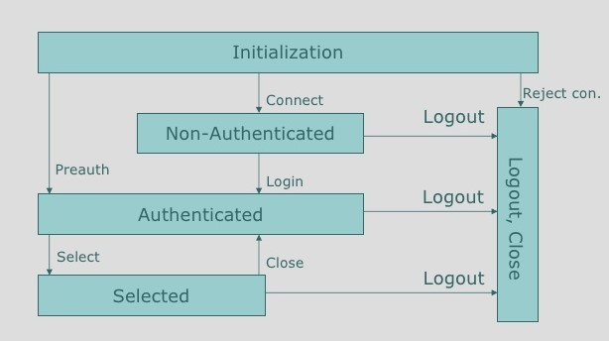
State Diagram

Slide 9
Flags Message Attributes
List of token associated with the message that is sent by the server
A flag can be permanent or session-only
Types :
System flag :
Flag name that is pre-defined in the map specification
All system flags begin with ‘\’
Keywords:
A keyword is defined by the server implementation
Keywords don't begin with ‘\’

Slide 10
Commands
LOGIN username password
SELECT mailbox-name
CREATE new-mailbox-name
DELETE mailbox-name
RENAME old-name new-name
AUTHENTICATE
CLOSE
SEARCH
COPY

Slide 11
THANK YOU

